Slide 1




SUPERSTORE ANALYSIS

Slide 2


AGENDA:
Overview.
Data cleaning.
Data modelling:
Story telling & analysis.
Forecasting.

Slide 3

DATA CLEANING
SAVE CLEANED DATA
CHECK FOR DUPLICATES
CHECK DATA TYPES
HANDLE MISSING DATA
UNDERSTAND THE DATA

Slide 4


DATA MODELING
CUSTOMER ID (PRIMARY).
CUSTOMERS INFORMATION.
NEW_PRODUCT_ID (PRIMARY).
ORDERS INFORMATION.
CUSTOMER,NEW_PRODUCT_ID (FOREIGN)
PRODUCTS INFORMATION.

Slide 5

STORY TELLING & ANALYSIS.

Slide 6

OUR TIME PERIOD
30/12/2018
3/1/2015

Slide 7
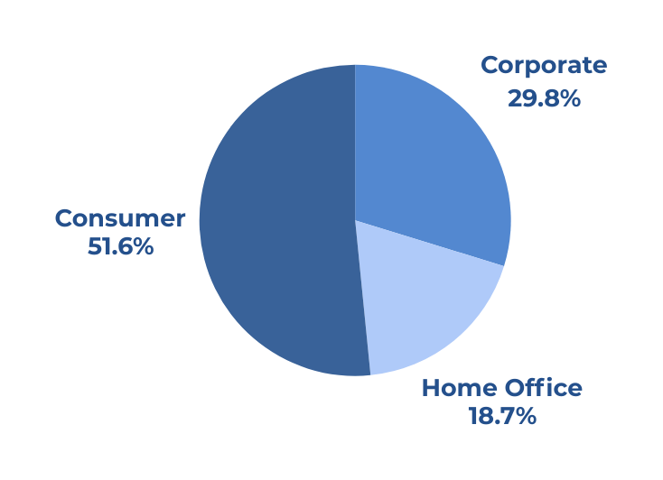
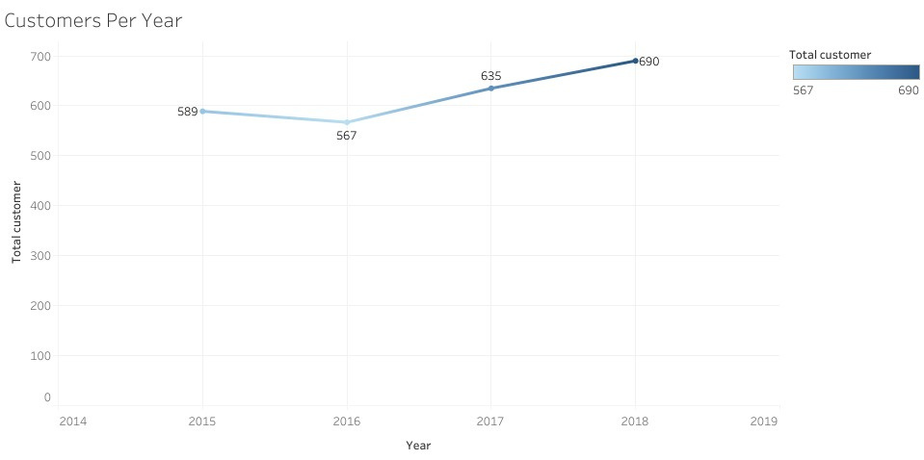
CUSTOMERS KPIS
TOTAL CUSTOMERS: 793.
CUSTOMERS PER SEGMENT
CUSTOMERS PER YEAR

Slide 8
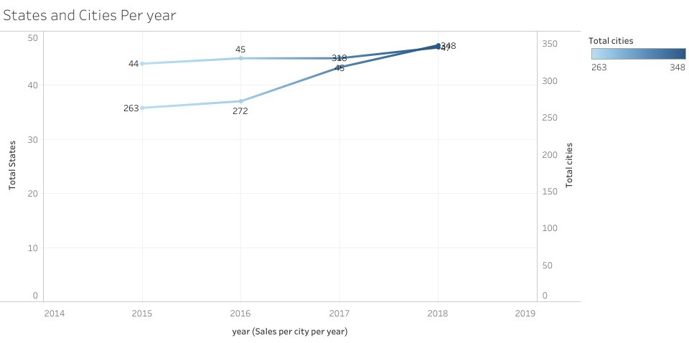
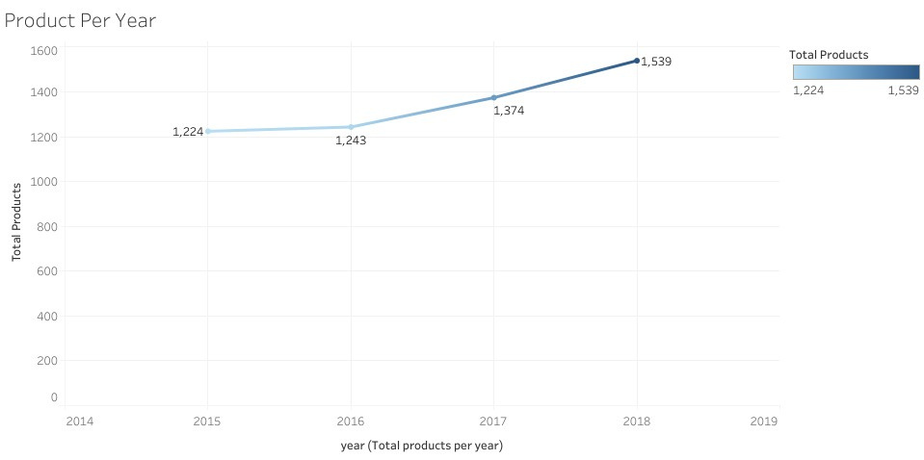
CUSTOMERS
NO. PRODUCTS PER YEAR
NO. STATES AND CITIES PER YEAR

Slide 9
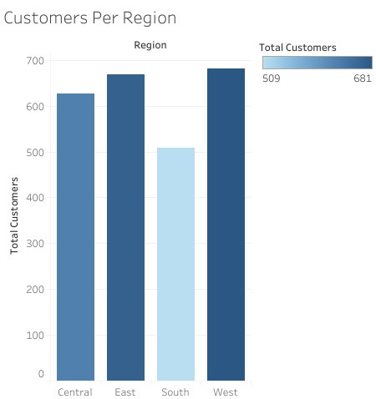
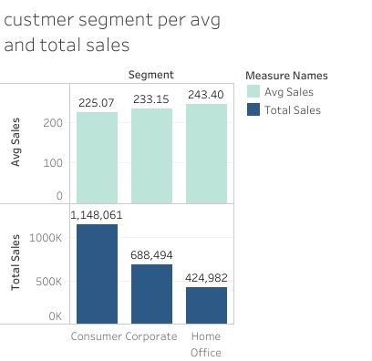
CUSTOMERS
NO. CUSTOMERS PER REGION
TOTAL & AVG SALES PER SEGMENT

Slide 10



PRODUCTS KPIS
TOTAL PRODUCTS: 1861.
TOTAL CATEGORIES: 3.
TOTAL SUB_CATEGORY: 17.

Slide 11
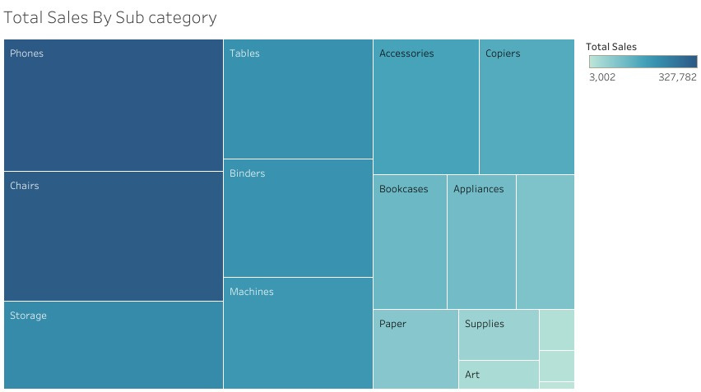
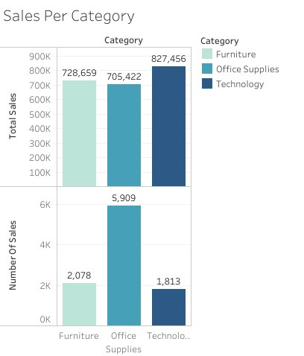
PRODUCTS
TOTAL SALES PER CATEGORY
TOTAL SALES PER SUB_CATEGORY

Slide 12
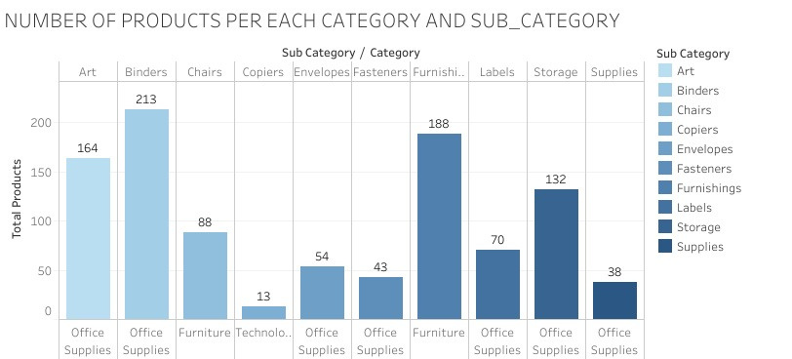
PRODUCTS

Slide 13

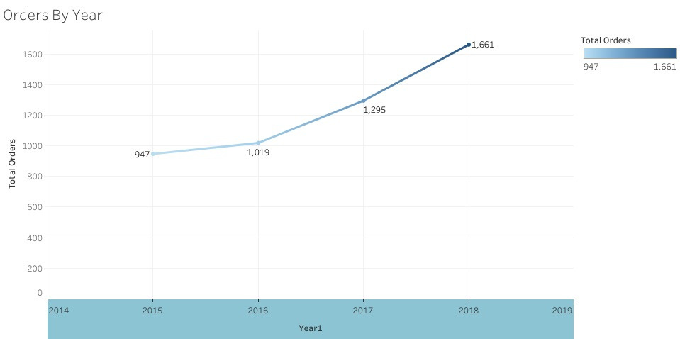
ORDERS KPIS
NO. ORDERS PER YEAR
TOTAL ORDERS: 4922.

Slide 14
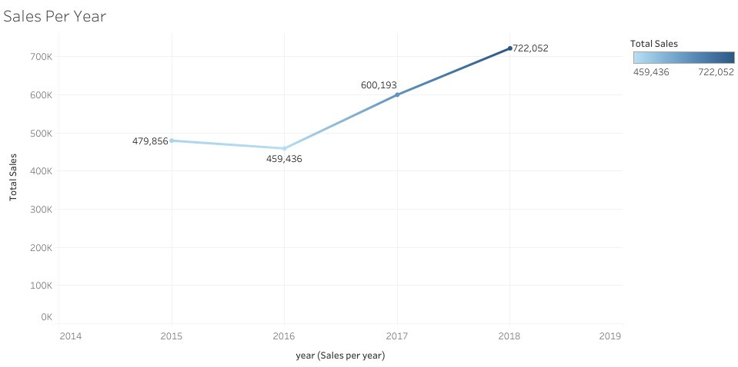
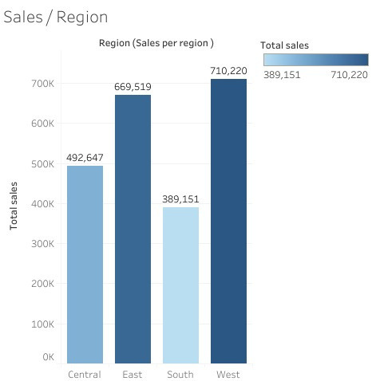
ORDERS
SALES PER REGION
TOTAL SALES PER YEAR

Slide 15
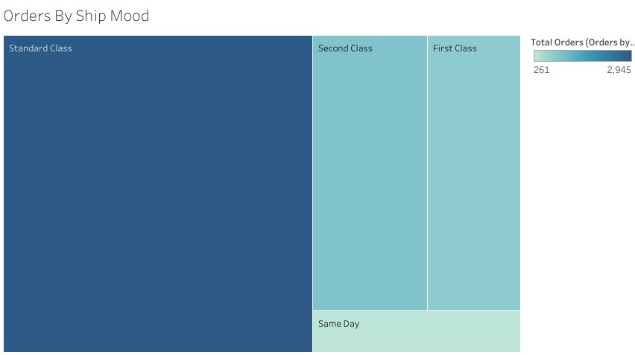
ORDERS
TOTAL ORDERS PER SHIP MODE

Slide 16
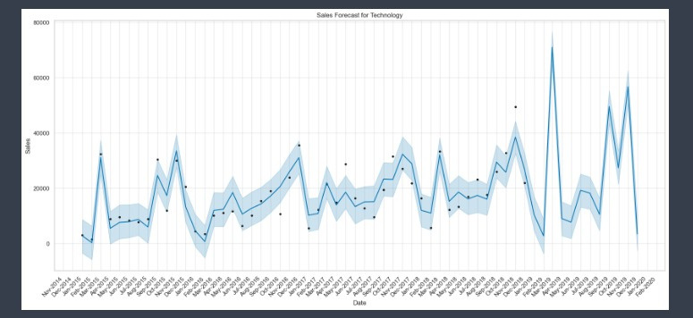
FORCASTING
SALES FORCAST FOR TECHNOLOGY CATEGORY

Slide 17
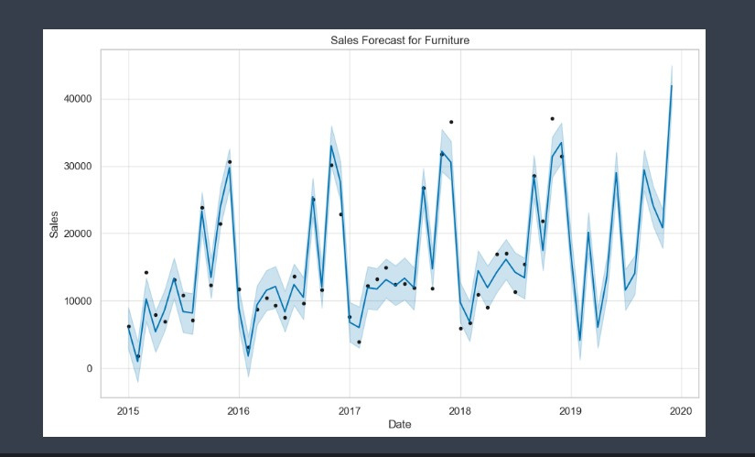
FORCASTING
SALES FORCAST FOR FURNITURE CATEGORY

Slide 18
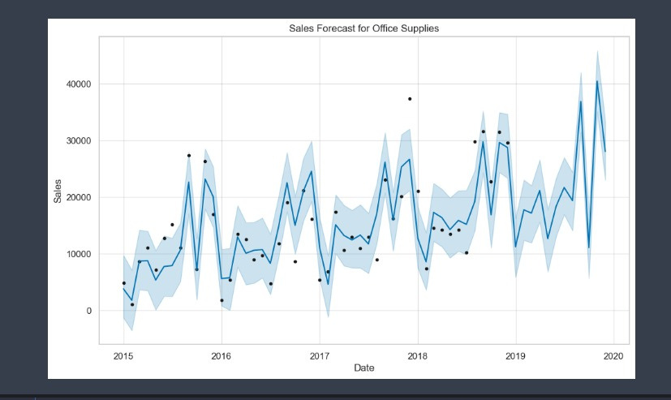
FORCASTING
SALES FORCAST FOR OFFICE SUPPLIERS CATEGORY

Slide 19
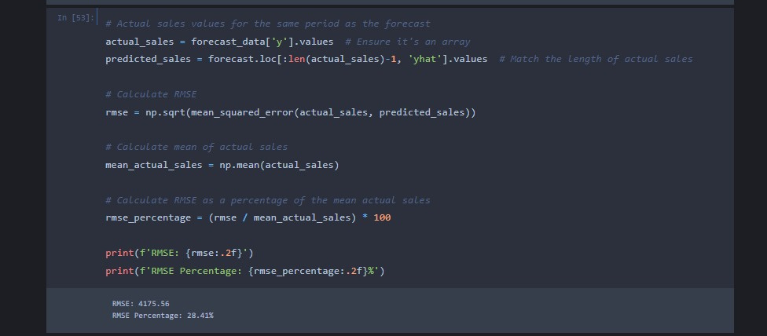
RMSE

Slide 20

THANK
YOU

